Slide 1
TDR Battery + Power cards
Powering the robot

Slide 2
Objective
Choose the perfect battery for the Robot by optimizing the energy / weight / resistance / price ratio.

Slide 3
1 - Input
The Robot shall be able to stay on for at least 30min without recharging the battery.
The minimum output voltage of the battery shall not be under 12V to ensure a good control of the motor’s RPM and meet the voltage requirements of the motors.
The Battery shall have a good discharge rate (‘C’ rating) to ensure a reasonable capacity pull without damaging the battery.
The battery shall resist to the discharge currents generated by the motors

Slide 4
2 - Analysis : Batteries Type
Li-Ion : best weight / capacity ratio, bad resistant and limited discharge rate
Li-Po : a good weight / capacity ratio and excellent discharge rate
NiMH : reasonable weight / capacity ratio, cheap, resistant but limited discharge rate
Pb : very bad weight / capacity ratio, but cheap, very resistant, safe and simple to use

Slide 5
2 - Analysis : Power needs
Motors : 2 Maxon motors (DCX 22 S Ø22 mm) 12V and Pm = 14W each
Arduino card : Pa = U*I = 5V*1A = 5W
Sensors : powered by the Arduino card
Servo-motor (if there is one) : powered by the Arduino card, and won’t be working at the same time as motors
Raspberry Pi : Pr = U*I = 5W
Total power : Pt = 2*Pm + Pa + Pr = 38 W
Notes:
Ok pour la conso moyenne, ajouter un coef de sécurité genre *2 pour les pics de courant

Slide 6
2 - Analysis : What capacity ?
Energy (Wh) = tension (V) * capacity (Ah).
We need around 20Wh in order to stay on for at least 30min without recharging the battery.
Capacity = 20/12 = 1.7 Ah = 1700 mAh at least

Slide 7
2 - Analysis : Shall we separate
Motor’s and electronic Batteries ?
Most of the time, separating Motor’s Battery and electronic ones is a good idea due to 2 reasons :
Electronic devices (such as Arduino card) have small variations in electrical current at the opposite of motors : a Li-on battery can be perfect because it delivers a stable tension and it’s lightweight.
The discharge due to current variations of the motors can cause the cards reboot for example.

Slide 8
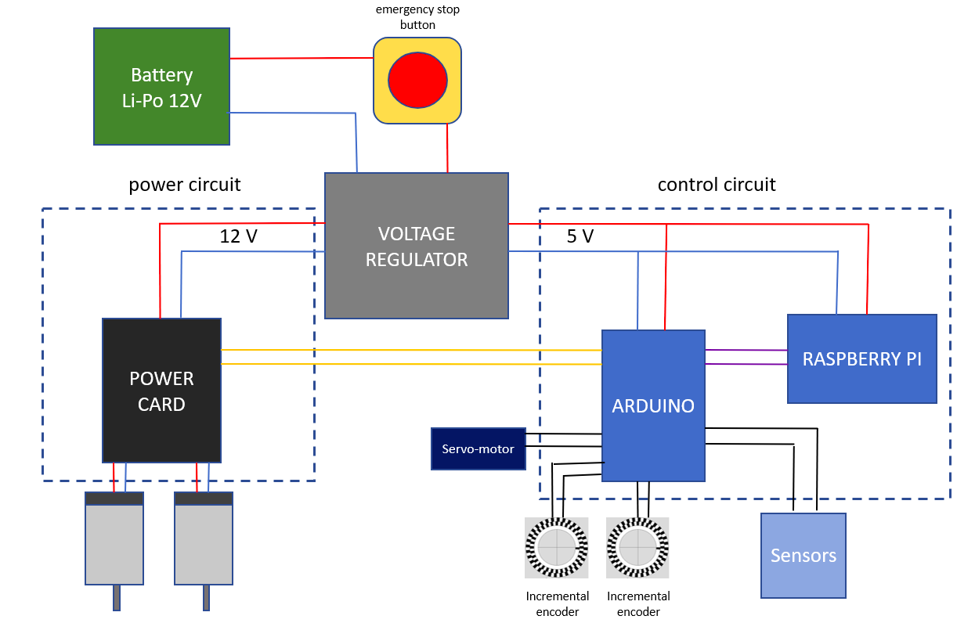
2 - Analysis : Another solution
A more practical solution is to use a voltage regulator to stabilise the electrical tension according to the electrical diagram (adjacent).
This solution allows us to save the interior space of the robot.
Battery
NiMh 12V
Notes:
Mon conseil : mettez le bouton d’emergency stop uniquement sur la partie power (et pas sur la partie commande), ça permet de l’utiliser sans rebooter l’elec et c’est tout aussi safe.
Une question : y-a-t-il vraiment besoin de l’Arduino ? Possibilité de tout brancher directement sur le raspbrery pi par les bonnes cartes d’interface toute faite (comme pour le contrôle moteur) ? Cela permet de n’avoir qu’un sw à gérer et rend le dev bcp plus agile.

Slide 9
3 - Choice : The battery
Our first choice was a LiPo battery with 4 cells (14.8V) and a capacity of 3000mAH. The problem is that LiPo batteries have bad resistant and high explosion risk. The use of a safe bag is mandatory for the cup and it would be a loss of space.
The best choice was a NiMH battery with 12V voltage and a capacity of 2800mAh because it’s safer and easier to use.

Slide 10
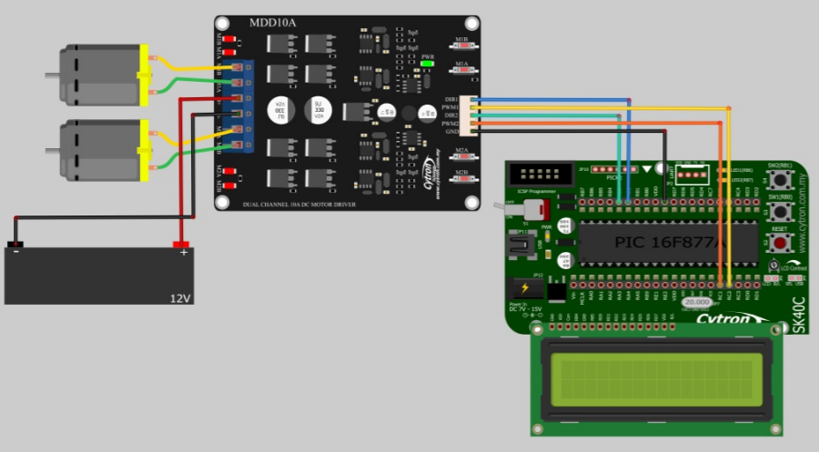
3 - Choice : Motor driver
Last year, the team used Cytron products for the tension regulator and the motor drivers. They had no problems using them, so we will choose the same products :
A dual channel motor driver
(we will buy 3 of them in case
of accidental destruction)
Notes:
Est-ce que cette carte sait recevoir les inputs des codeurs (et faire la régulation en vitesse des moteurs) ?
Si oui c’est un gros plus. Si ce n’est pas le cas, ça vaut le coup de se poser la question de passer à une carte qui sait le faire.

Slide 11
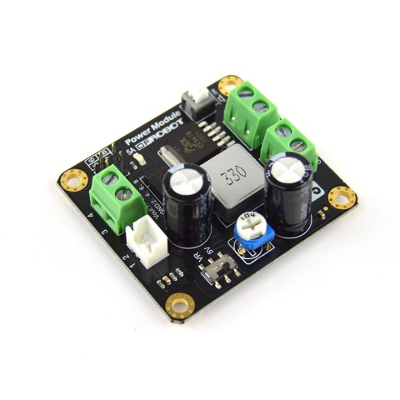
3 - Choice : Tension regulator
Two DC-DC power converters (tension regulator) with two outputs (12V and 5V)
We will need two of them for the robot, as the maximum output power of one card is 25W and the expected peak power of our robot will be around 40W. We will buy 5 of them (in case of accidental destruction).
Notes:
Pas clair : je ne vois pas comment vous pouvez répartir les watts entre plusieurs.
Et j’ai l’impression qu’il n’y a pas besoin de DC-DC pour le driver de moteur.
Donc je dirais qu’un DC-DC pour l’elec de contrôle suffit.

